Slide 1
Website Design Principles

Slide 2
1. Good Design

Slide 3
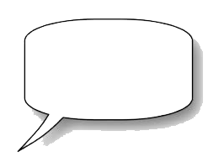
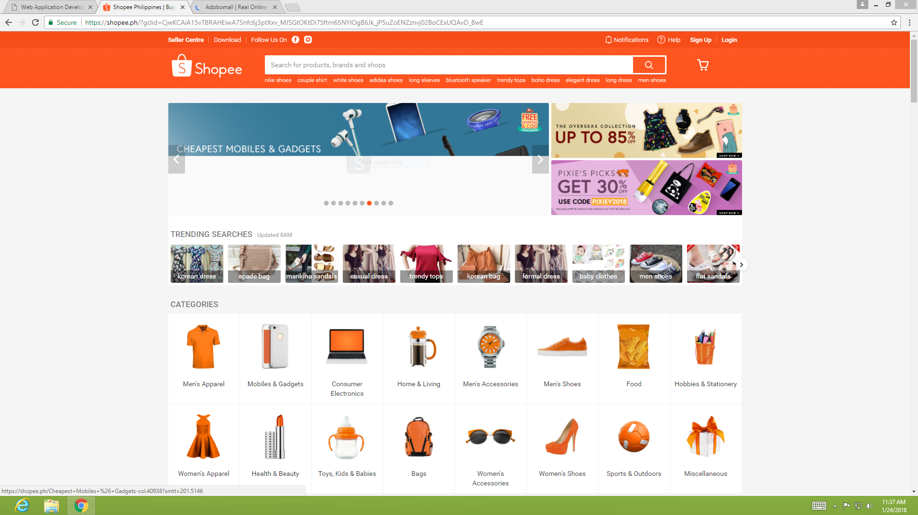
Shopee Homepage
The Design of this
website is grid and
informative,it uses the right
color andsame fonts
in each links.
Active White
Space
Passive White
Space

Slide 4
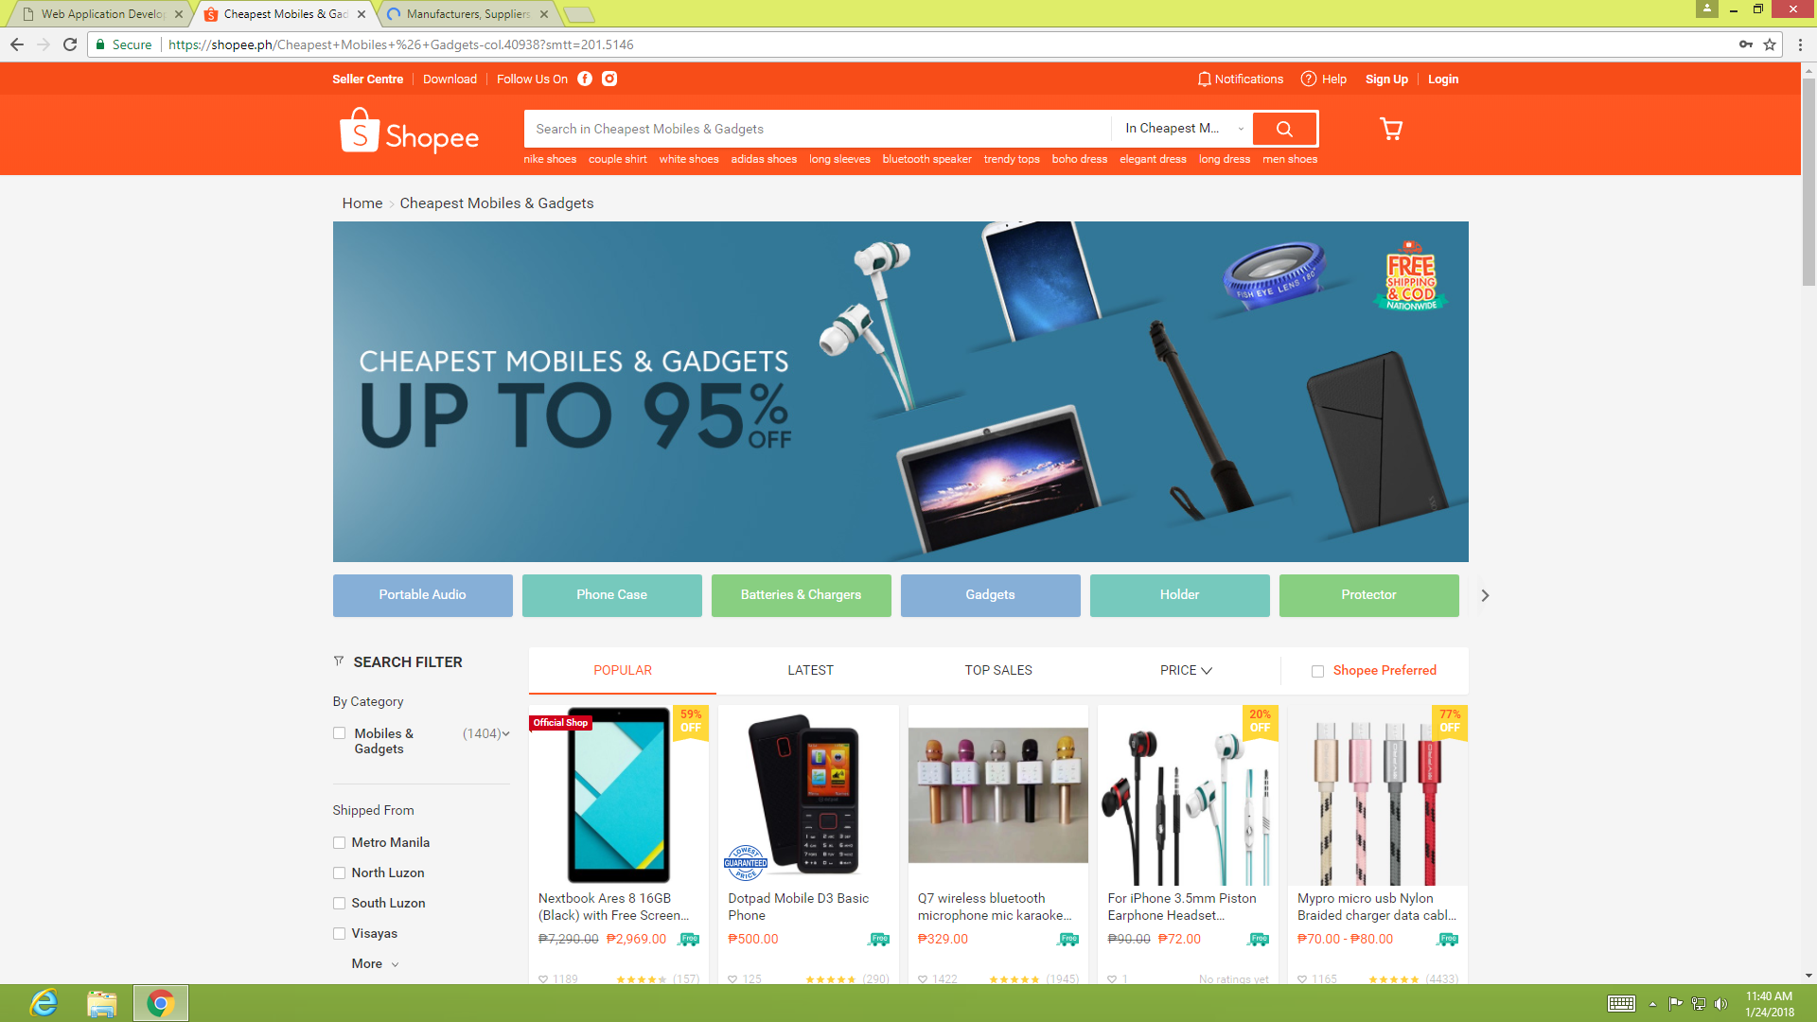
Shopee Product Website
The product site of shopee
contains the same links,
it's organize just
like the homepage.So does it
make it a good website

Slide 5
2. Poor Web Design

Slide 6
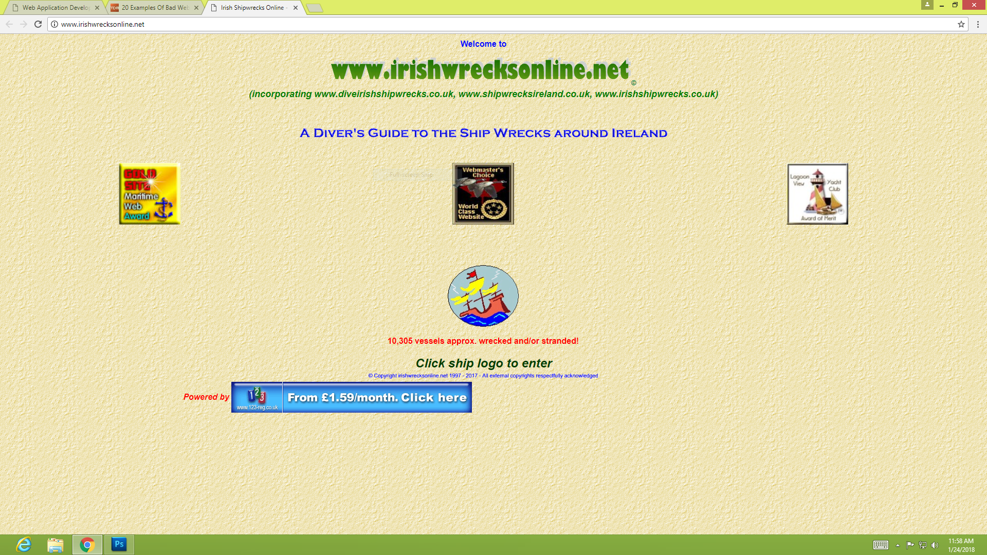
Lack of information
No Navigation bar
Font Style such as
Font Family are
not using same element
No divisions,
Layout inappropriate
Active and Passive
white Space
Cannot be determine

Slide 7

3. Critique Essay(Zalora.com)
To design the webpage base on how it portray ZALORA to represent itself to the mass consumer market. The first thing was to analyse the websites current design and identify the problems that needs to be rectified.
Too many info makes people confuse, cant distinguish which icon is more important than others, the menu bar could be further simplified, key elements of the page should be restructed. Could be bolder, contast the page backgound and foreground . The Heading and text box are dont pop out too subtle,there needs to be a clear view on the headings. Text boxes color are too harsh on the images, should have a soft color gradient on top of the promating images.The images arent uniformly structed. Mix of horizontal and vertical alignment.

Slide 8
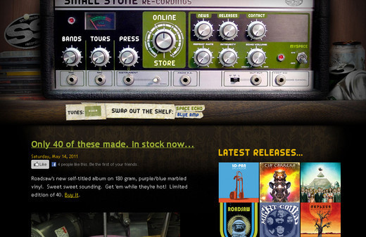
4. Unique Navigation Methods (essay)
Navigation is the most important part of a website without which no website can effectively operate. Achieving unique navigation that effectively fulfills its purpose is nearly akin to climbing Mount Everest. Having a unique navigation with perfect functionality makes the website easy to navigate, thus ensuring a better users experience.
Small Stone
The navigation of this site goes with the theme. This is a website of a US based record label that is evident through its navigation.

Slide 9
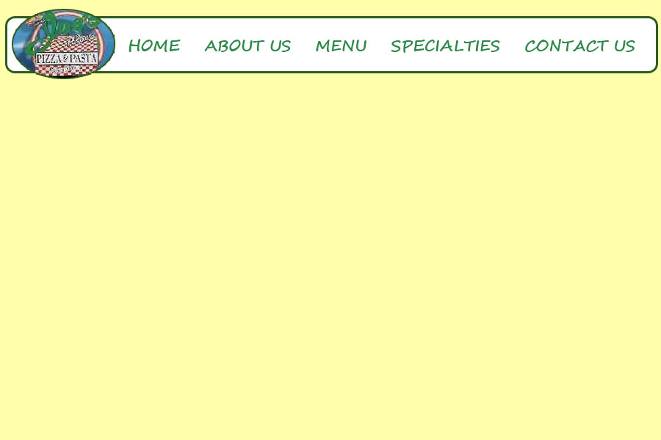
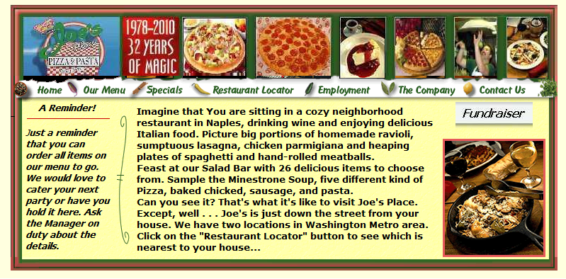
Number 5, still on process.......
Before
After

Slide 10
6.Test cross-browser compatibility.
On Opera Browser
Similar to chrome it gave good graphic on both zoomed and normal layout.
Bolder text conceptualization

